Slide 1
Longing for Heaven
Philippians 3:19-20 (NIV) – Their destiny is destruction, their god is their stomach, and their glory is in their shame. Their mind is on earthly things. But our citizenship is in heaven. And we eagerly await a Savior from there, the Lord Jesus Christ.

Slide 2
Longing for Heaven
1Corinthians 12:4 – And he heard things that cannot be told, which man may not utter.

Slide 3
Longing for Heaven
Matthew 13:44 – The kingdom of heaven is like a treasure hidden in a field, which a man found and covered up. Then in his joy he goes and sells all that he has and buys that field.

Slide 4
Longing for Heaven
Hebrews 11:13-16 – These all died in faith, not having received the things promised, but having seen them and greeted them from afar, and having acknowledged that they were strangers and exiles on the earth. For people who speak thus make it clear that they are seeking a homeland.

Slide 5
Longing for Heaven
If they had been thinking of that land from which they had gone out, they would have had opportunity to return. But as it is, they desire a better country, that is, a heavenly one. Therefore God is not ashamed to be called their God, for he has prepared for them a city.

Slide 6
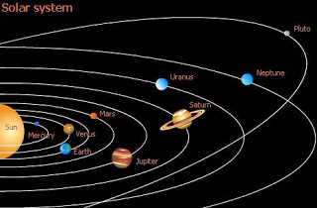
Longing for Heaven

Slide 7
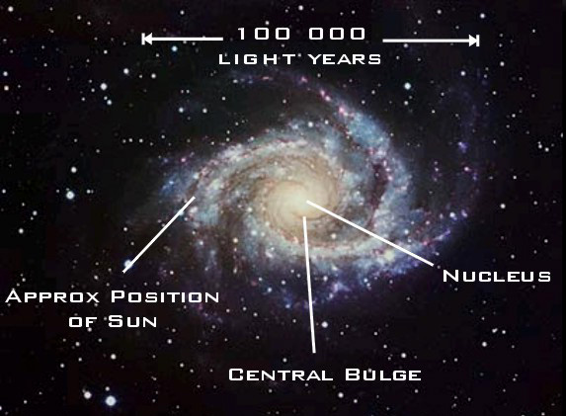
Longing for Heaven

Slide 8
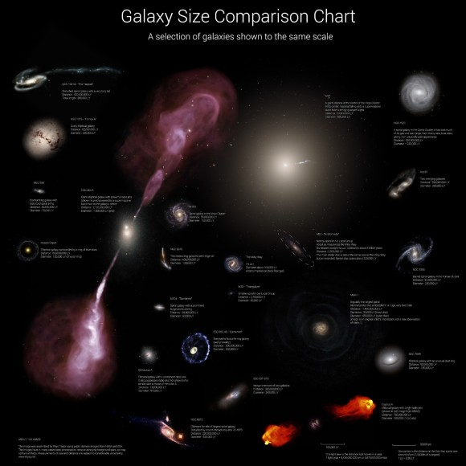

Slide 9
Longing for Heaven
Isaiah 65:17 – For behold, I create new heavens and a new earth, and the former things shall not be remembered or come into mind.

Slide 10
Longing for Heaven
Revelation 21:1-2 – Then I saw a new heaven and a new earth, for the first heaven and the first earth had passed away, and the sea was no more. And I saw the holy city, new Jerusalem, coming down out of heaven from God, prepared as a bride adorned for her husband.

Slide 11
Longing for Heaven
John 14:2 (ESV) – In my Father’s house are many rooms. If it were not so, would I have told you that I go to prepare a place for you.

Slide 12
Longing for Heaven
John 14:2 (NKJV) – In my Father’s house are many mansions; if it were not so, I would have told you. I go to prepare a place for you.

Slide 13
Longing for Heaven
Revelation 10:1-3 – Then I saw another mighty angel coming down from heaven, wrapped in a cloud, with a rainbow over his head, and his face was like the sun, and his legs like pillars of fire. He had a little scroll open in his hand.

Slide 14
Longing for Heaven
And he set his right foot on the sea, and his left foot on the land, and called out with a loud voice, like a lion roaring. When he called out, the seven thunders sounded.

Slide 15
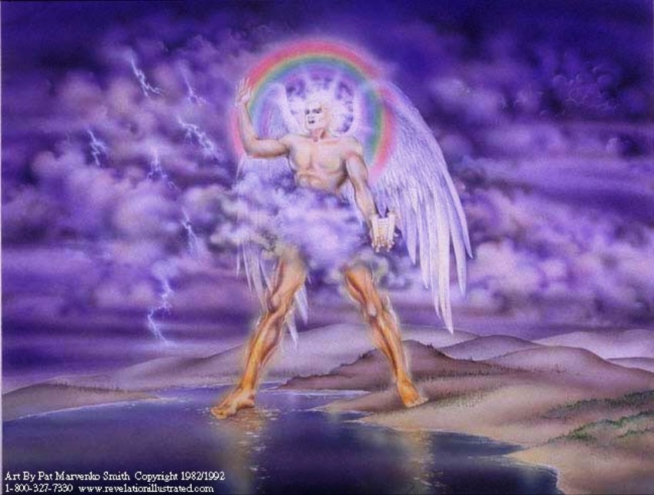
Longing for Heaven
Song of Songs 2:7 (3:5, 8:4) – I adjure you, O daughters of Jerusalem, by the gazelles or the does of the field, that you not stir up or awaken love until it pleases.

Slide 16
Longing for Heaven
Revelation 17:19 – Then I saw an angel standing in the sun, and with a loud voice he called to all the birds that fly directly overhead, “Come, gather for the great supper of God.”

Slide 17
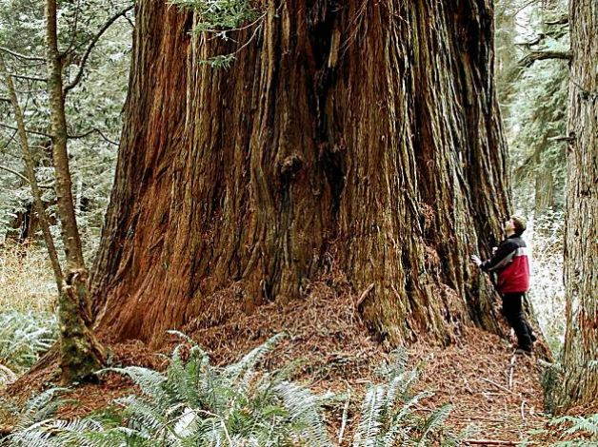
Longing for Heaven
Song of Songs 2:7 (3:5, 8:4) – I adjure you, O daughters of Jerusalem, by the gazelles or the does of the field, that you not stir up or awaken love until it pleases.

Slide 18
Longing for Heaven

Slide 19
Longing for Heaven
Song of Songs 2:7 (3:5, 8:4) – I adjure you, O daughters of Jerusalem, by the gazelles or the does of the field, that you not stir up or awaken love until it pleases.

Slide 20
Longing for Heaven
Matthew 6:20-21 – But lay up for yourselves treasures in heaven, where neither moth nor rust destroys and where thieves do not break in and steal. For where your treasure is, there your heart will be also.

Slide 21
Longing for Heaven
Matthew 5:3, 10 – Blessed are the poor in spirit, for theirs is the kingdom of heaven. Blessed are those who are persecuted for righteousness’ sake, for theirs is the kingdom of heaven.

Slide 22
Longing for Heaven
Revelation 21:4 – He will wipe away every tear from their eyes, and death shall be no more, neither shall there be mourning, nor crying, nor pain anymore, for the former things have passed away.

